Slide 1
Packet – Intro
Packets are received from NTU.
Checksum is calculated to see if the packet header is damaged.
The CID is extracted from the header.
The extracted CID is compared against the TTU CID list to verify that the packet belongs to this TTU.
The packet is ignored if its CID is not in the list.
Otherwise, the packet is forwarded in one burst.
Z RBA

Slide 2
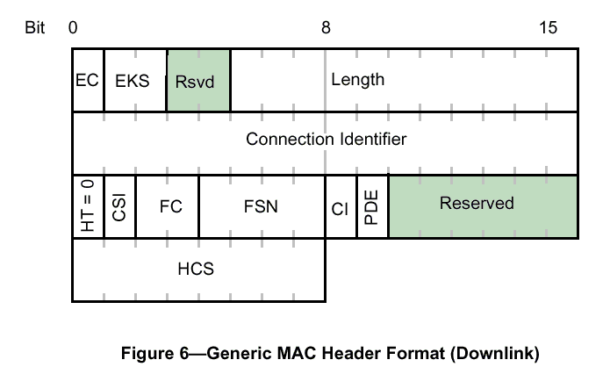
Packet filtering – IEEE 802.16
Packet Header
Z RBA

Slide 3
Packet filtering – CID comparison code
# pc = 31 : loop 1 10 16
# pc = 32 : RAM[R7++]=R4
# pc = 33 : wait c2 R4=s0
# pc = 34 : RAM[R7++]=R4
# pc = 35 : R0=R7
# pc = 36 : R7=R3
# pc = 37 : breakif R2==R6=RAM[R7++]
# pc = 38 : R3=R7
# pc = 39 : wait c2 R4=s0
# pc = 40 : R7=R0
# pc = 32 : RAM[R7++]=R4
# pc = 33 : wait c2 R4=s0
Loop while searching CID array
Loop Start
Get input data
Write it to memory
Switch memory context
Check if CID matches table entry
Switch back memory context
Get another input Data
Loop End
Start loop again
Z RBA

Slide 4
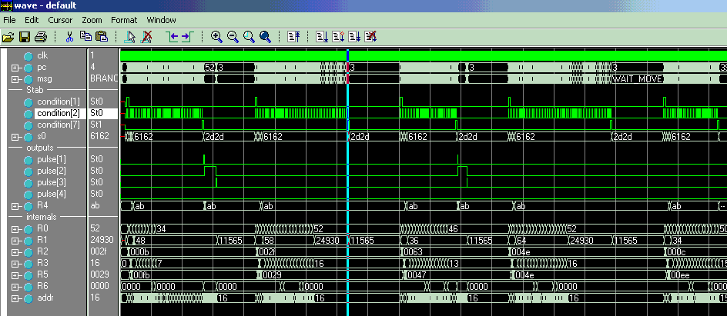
Packet filtering – Simulation
Packet Received
Packet Extracted in burst
Packet ignored

Slide 5
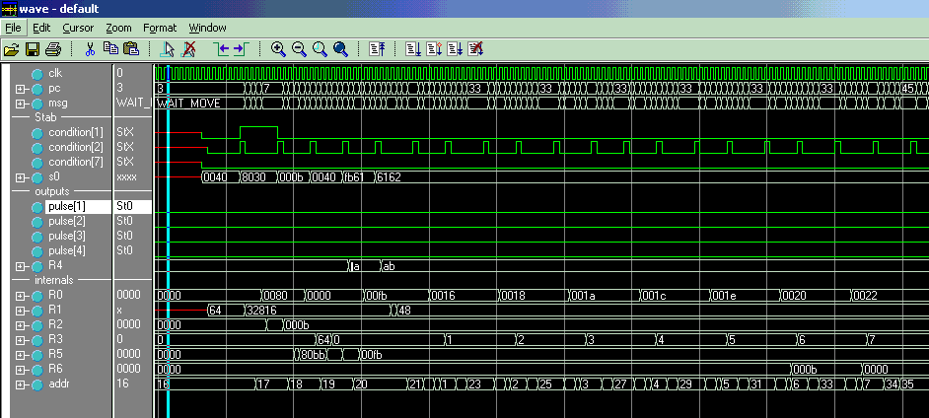
Packet filtering – CID comparison
Packet CID
CID extracted to R2
CID searched in memory
CID Found

Slide 6
OHP – SCS GlueLess connection
Synchronous
Busy
OHP
D_valid
D_start
Data
3xx Mhz
3xx/2 Mhz
Clock
Busy
D_valid
DO Work
D_Start
Data
SM,PM, TCM1-6,…. – 11 bytes every frame
Z RBA

Slide 7
Debounce/Stability check – Breakout into steps
Every OTN frame (3us) the OTN Rx OHP sends 11 bytes comprising the
SM, PM, TCM1-6, TCM-ACT, FTFL, PSI byte captured for the j frame..
The bytes received by the SCS in one long burst directly to a cyclic buffer
implemented in its data ram.
The 11 bytes belong to frame j, are compared to those of the frame j-64
that resides in the SCS cyclic buffers.
The compare results affect the state variables of the process that are kept
in a predefined location in the data memory.
If the state change to a degree that requires reporting to the “host”, a
suitable message is formed and send to the “host” (yet, not shown).
Every 128 frames – 2 message length, the cyclic buffer that holds the current
and the previous messages wrap around.
The typical number of cycles for this procedure is ~100 => 20% utilization.
In the rare cases, where this procedure undergo the longest path, utilization
raises to ~60%.
The simple procedure shown, takes 50 instructions. The estimation for the
complete flow is under 200.
Z RBA

Slide 8
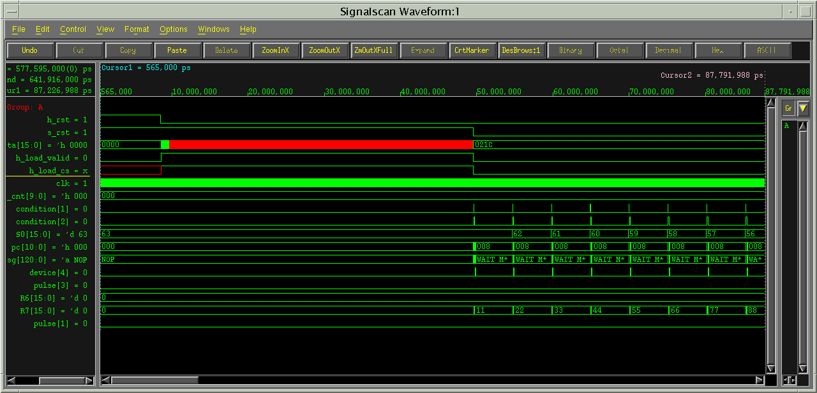
Overview of the micro-code download,
and the first 4 frames processing.
- The signal in red shows that after
a hard reset, where the micro-code upload
starts, most of the instruction ram is
filled with x, which represents an unused
space.
-
Debounce Case Study
Micro-code upload followed
by the first 4 frames.
H_rst
Soft_rst
Host_Mcode
H_load_valid
H_load_cs
Clk
OTN_OHD_start
OTN_OHD_valid
OTN_OHD_data
PC
Instruction

Slide 9
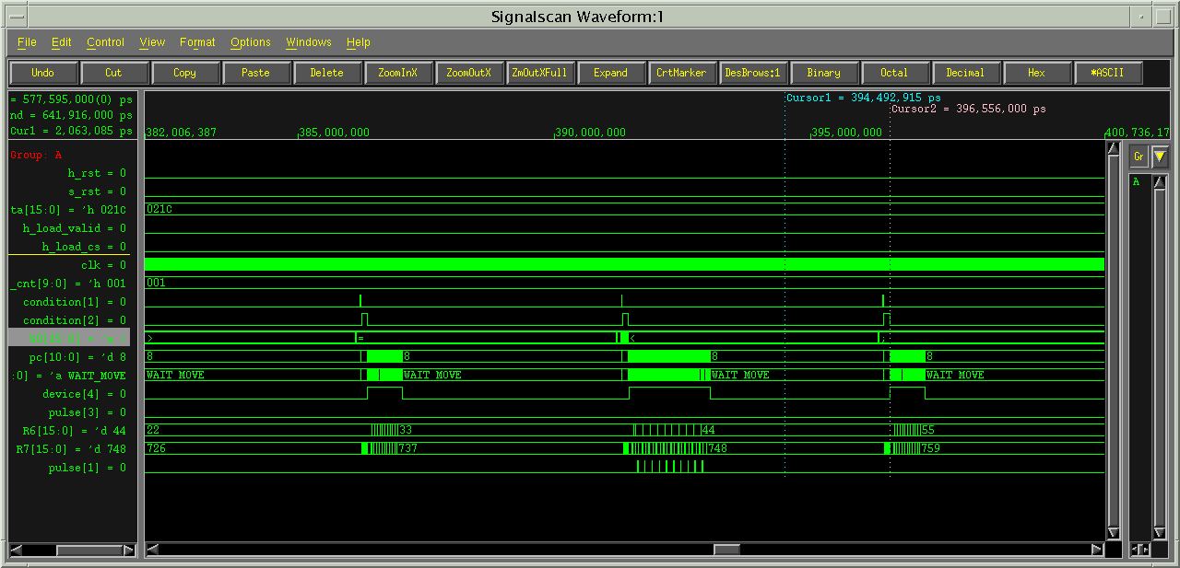
Debounce Case Study
Inter frame free utilization
H_rst
Soft_rst
Host_Mcode
H_load_valid
H_load_cs
Clk
OTN_OHD_start
OTN_OHD_valid
OTN_OHD_data
PC
Instruction
75~80% Free

Slide 10
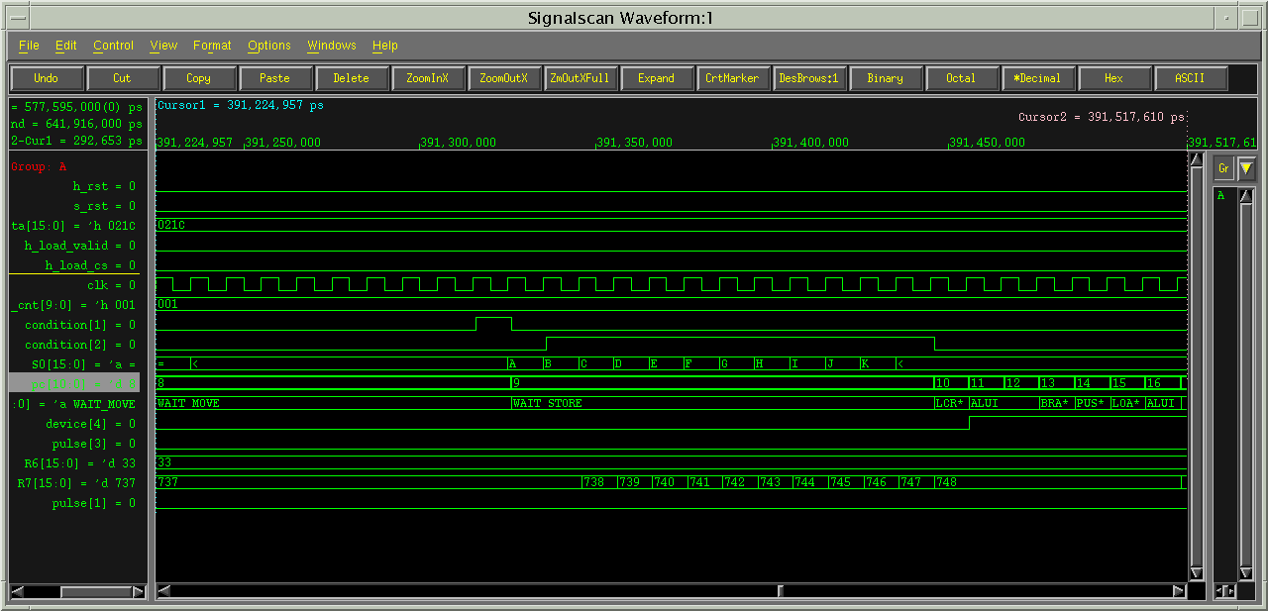
Zoom on single frame …..
The SCS is in idle state waiting
for the transaction from the OHP
to commence.
Data capturing from the OHD
is shown (11 bytes).
Once the data is captured into the
SCS data memory, the processing
starts.
Debounce Case Study
In frame, Data capture followed
by start processing
H_rst
Soft_rst
Host_Mcode
H_load_valid
H_load_cs
Clk
OTN_OHD_start
OTN_OHD_valid
OTN_OHD_data
PC
Instruction
sm
Command under execution

Slide 11
In Frame Micro-Scheduling
Data Capture from OHD processor
Register File Rd/Wr
Host Access SCS
SCS Access Host
De-Bounce/Stability processing
With host intervention
Every 64 frames
Normal
0
500
Intra frame time base – measured in cycles of the SCS clock.
Assuming 3us frame time and 3xx/2 Mhz clock, we get ~500 cycles
Z RBA

Slide 12
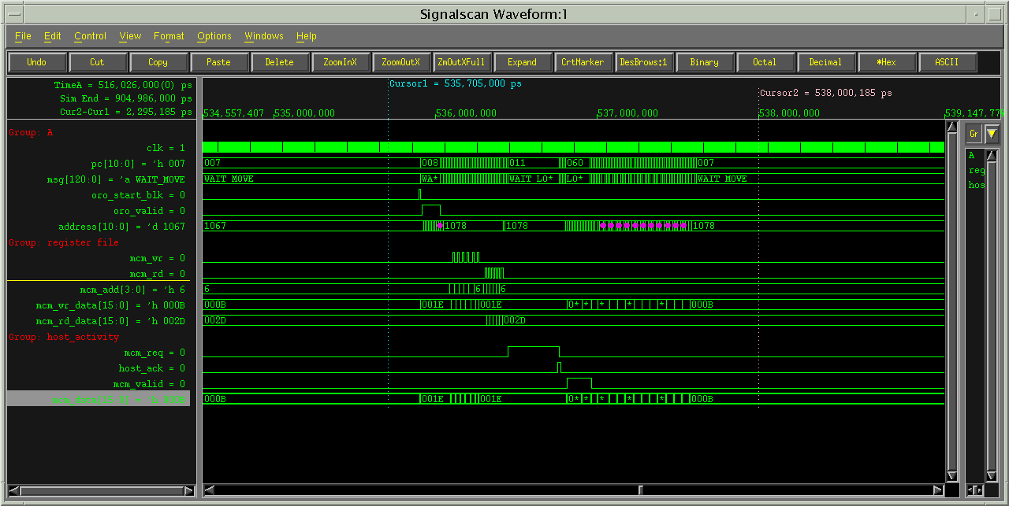
The bigger picture
Debounce, Register file access and
Host interaction, all in single frame.
Clk
PC
Instruction
OTN_OHD_start
OTN_OHD_valid
Dmem_ADD
Rfile Signals
Rfile_wr
Rfile_rd
Rfile_Add
Rfile_wr_data
Rfile_rd_data
Host Signals
SCS_req
Host_ack
SCS_valid
SCS_DATA

Slide 13
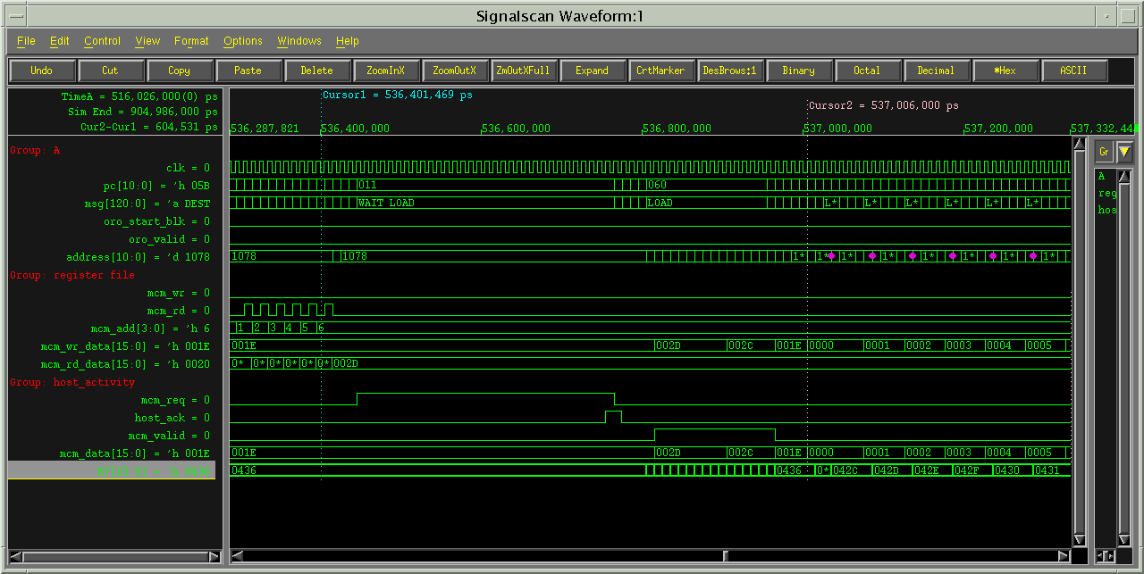
The bigger picture
Zoom on Host interaction
Clk
PC
Instruction
OTN_OHD_start
OTN_OHD_valid
Dmem_ADD
Rfile Signals
Rfile_wr
Rfile_rd
Rfile_Add
Rfile_wr_data
Rfile_rd_data
Host Signals
SCS_req
Host_ack
SCS_valid
SCS_DATA

Slide 14
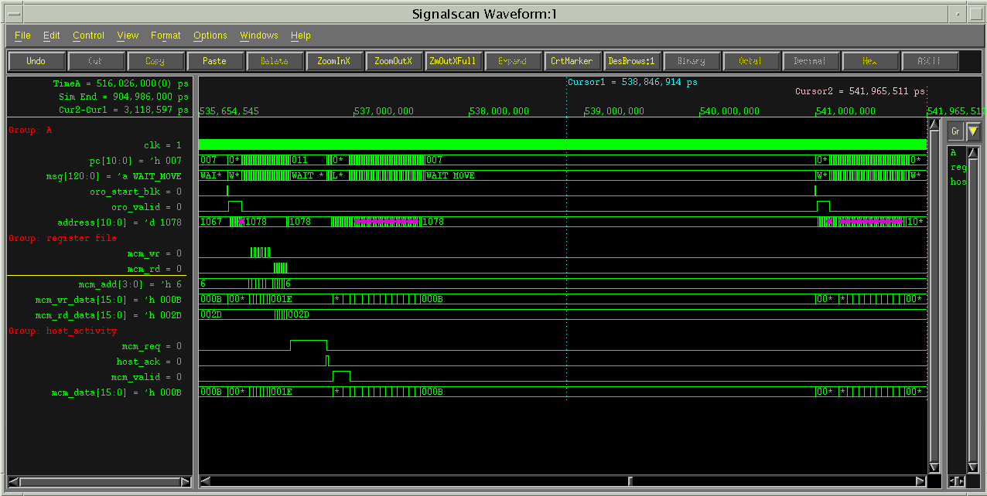
The bigger picture
All activities and still free bandwidth
Clk
PC
Instruction
OTN_OHD_start
OTN_OHD_valid
Dmem_ADD
Rfile Signals
Rfile_wr
Rfile_rd
Rfile_Add
Rfile_wr_data
Rfile_rd_data
Host Signals
SCS_req
Host_ack
SCS_valid
SCS_DATA
Free Bandwidth

Slide 15
Source Code
// working with oro stub
// so - oro_data
// c2 - oro_valid
// c1 - oro_start_blk
assign RES=2000
nop
L_init, R7 = 0 // pointer to the address
R2 = 0 // first message flag
R1 = 0 // count the 64 messages
R0 = 0 // switch flag
R6 = 0
L_blk, loop L_read L_read 11
device_1 -> 4'b0000
wait c1 R3=s0 // wait for start_blk
L_read, wait_store c2 RAM[R7++]=R3=s0
device_1 -> 4'b0001
R1=R1+1
if (R2 == 1) { // compare at every frame ( not at the first message)
push R3 // and save the result at RAM[RES]
R3 = 0
R7 = R7-11
loop L_cmp L_cmpend 11 // compare the 11 values to the previous ones
L_cmp, R5 = RAM[R7++]
R4 = RAM[R6++]
if (R5 != R4) {
pulse -> p1
push R7 R2 R1
R7 = RES // update result
R2 = RAM[R7]
R1 = 1
R1 = R1 << R3
R2 = R2 | R1
RAM[R7] = R2
pop R7 R2 R1
}
L_cmpend, R3 = R3+1 // R3 runs between 1..11
pop R3
}
if (R1 == 64) { // at the end of every message
push R7
R7 = RES
R1 = RAM[R7] // output the result
pulse -> p3 // with pulse
nop
nop
R1 = 0 // Reset the result for next iterration
RAM[R7] = R1
pop R7
R2 = 1
if (R0 == 0) { // switch flag
R0 = 1
R6 = 0
}
else {
R0 = 0
R7 = 0
}
R1 = 0
}
goto L_blk
Z RBA

Slide 16
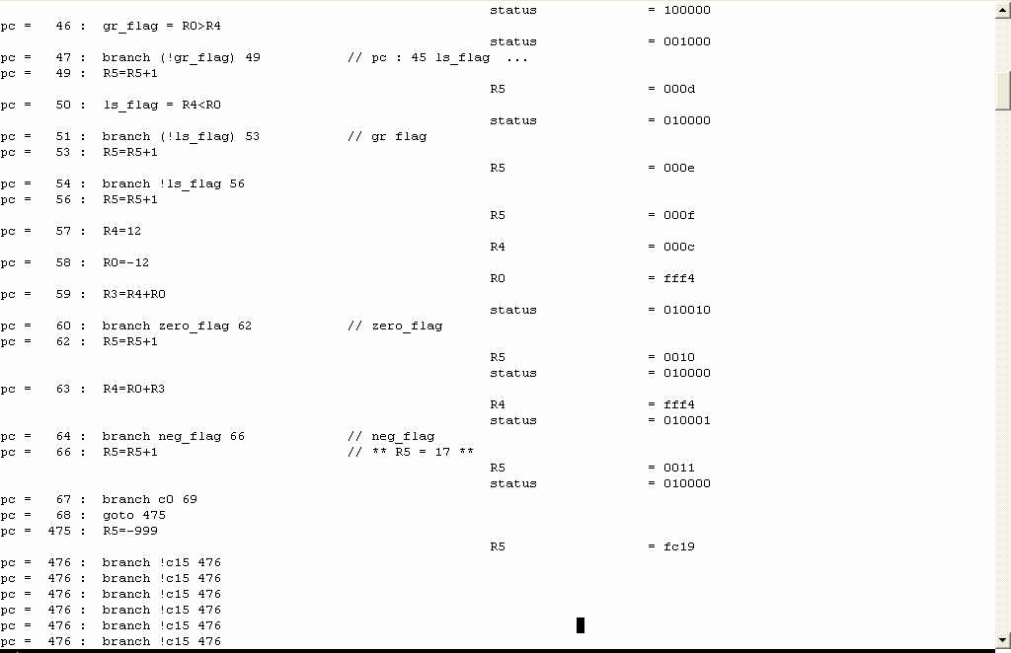
Simulation Log
Zorba Technologies LTD.
info@zorba-tec.com
Feb 22 2004

Slide 17
Micro Code
// working with oro stub
// so - oro_data
// c2 - oro_valid
// c1 - oro_start_blk
//
// assign RES=2000
//
00000000000000000000000000 // ( 0) 0000000 NOP nop *
00111000111000000000000000 // ( 1) 0e38000 LOAD_I R7 = 0 * pointer to the address
00111000010000000000000000 // ( 2) 0e10000 LOAD_I R2 = 0 * first message flag
00111000001000000000000000 // ( 3) 0e08000 LOAD_I R1 = 0 * count the 64 messages
00111000000000000000000000 // ( 4) 0e00000 LOAD_I R0 = 0 * switch flag
00111000110000000000000000 // ( 5) 0e30000 LOAD_I R6 = 0 *
01001111011000110000001011 // ( 6) 13d8c0b LOOP loop 3 3 11 *
00010110000000001011111111 // ( 7) 05802ff LCRLR device_1 -> 4'b0000 *
00101000011000100000001111 // ( 8) 0a1880f WAIT_MOVE wait c1 R3=s0 * wait for start_blk
01000000011001000000001111 // ( 9) 101900f WAIT_STORE wait_store c2 RAM[R7++]=R3=s0 *
00010110000000101011101111 // ( 10) 0580aef LCRLR device_1 -> 4'b0001 *
10001000001001100100000001 // ( 11) 2209901 ALUI R1=R1+1 *
//
….
…
…
00100110000001011000001111 // ( 42) 098160f STORE RAM[R7] = R1 *
10010100001000000000000000 // ( 43) 2508000 PUSHPOP pop R7 *
00111000010000000000000001 // ( 44) 0e10001 LOAD_I R2 = 1 *
10001000111000011100000000 // ( 45) 2238700 ALUI eq_flag = R0 == 0 *
10000111100110100000110010 // ( 46) 21e6832 BRANCH branch (!eq_flag) 50 * switch flag
00111000000000000000000001 // ( 47) 0e00001 LOAD_I R0 = 1 *
00111000110000000000000000 // ( 48) 0e30000 LOAD_I R6 = 0 *
10000111000111100000110100 // ( 49) 21c7834 BRANCH branch true_bit 52 *
//
00111000000000000000000000 // ( 50) 0e00000 LOAD_I R0 = 0 *
00111000111000000000000000 // ( 51) 0e38000 LOAD_I R7 = 0 *
//
00111000001000000000000000 // ( 52) 0e08000 LOAD_I R1 = 0 *
//
10000111000111100000000110 // ( 53) 21c7806 BRANCH branch (true_bit) 6 *
//
@07fe
10000111000111111111111110 // ( 2046) 21c7ffe BRANCH branch (true_bit) 2046 * debug pointer
@07ff
10000111000111111111111111 // ( 2047) 21c7fff BRANCH branch (true_bit) 2047 * Interrupt pointer

Slide 18
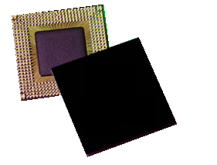
Zorb1 3202
Zorba Technologies LTD
zorba@zorba-tec.com

